Slide 1
CLOUD BASED BIOMETRIC SECURITY FOR ORGANIZATIONS
BATCH NUMBER - 14
TEAM MEMBERS
aBHINAYA R(2017PECCS101)
PRIYANKA B(2017PECCS201)
ABITHA C(2017PECCS102)
PROJECT GUIDE
r.Salini
Assistant professor
Cse department

Slide 2
ABSTRACT
The main aim of the project is used to derive a unique identity from the users biometric data which is further used to generate the user’s private key.
In this paper, we design a new biometric-based authentication protocol to provide secure access to a remote (cloud) server.
In addition, we propose an efficient approach to generate a session key between two communicating parties using two biometric templates for a secure message transmission.
In other words, there is no need to store the user’s private key anywhere and the session key is generated without sharing any prior information.

Slide 3
LITERATURE SURVEY
S.NO | YEAR | AUTHOR NAME | PROJECT TITLE | MERITS | DEMERITS
1. | 2019 | Wencheng Yang, Song Wang,Jiankun Hu, Guanglou Zheng and Craig Valli | Security and Accuracy of Fingerprint-Based Biometrics: A Review | One of the advantages of biometric cryptosystems is that they can bind or directly generate a cryptographic key, which can be used for both authentication and data encryption. | It is infeasible or computationally difﬁcult to retrieve raw template data.
2. | 2018 | Zhihua Xia, Xingming Sun, Neal N. Xiong | A Novel Weber Local Binary Descriptor for Fingerprint Liveness Detection | The method consists of two components: the local binary differential excitation component that extracts intensity-variance features and the local binary gradient orientation component that extracts orientation features. | The calculation model of local binary pattern (LBP) to improve the two components of the original WLD. The proposed WLBD overcomes the two imperfections of WLD and performs well in the FLD problem

Slide 4
S.NO | YEAR | AUTHOR NAME | PROJECT TITLE | MERITS | DEMERITS
3. | 2018 | Srinivas Jangirala, Mohammad Wazid | Anonymous Lightweight Chaotic Map-Based Authenticated Key Agreement Protocol for Industrial Internet of Things | A registered user is facilitated to update password & biometrics without the involvement of the GWN. | we present a new three-factor anonymous lightweight authentication protocol suitable for IIoT. The proposed scheme applies chaotic map and fuzzy extractor techniques.
4. | 2017 | Mohammad Wazid, Neeraj Kumar, Mauro Conti, Minho Jo | Design of Secure User Authenticated Key Management Protocol for Generic IoT Networks | The scheme is very efﬁcient as it uses only cryptographic hash function along with the symmetric encryption/decryption. | A user can access the information of any smart device of monitoring group through the central controller.

Slide 5
S.NO | YEAR | AUTHOR NAME | PROJECT TITLE | MERITS | DEMERITS
5. | 2017 | Mohammad Wazid, Neeraj Kumar, Mauro Conti, Minho Jo | Design of Secure User Authenticated Key Management Protocol for Generic IoT Networks | Different Scanners capture different feature so fingerprints with varying sizes. For higher accuracy, the network must be trained individually for each scanner. | Although transfer learning is an efficient approach to machine learning problems with a limited number of training samples, it has a disadvantage in that the computation time cannot be smaller than the pertained networks.
6. | 2017 | HO YUB JUNG1, YONG SEOK HEO2, SOOCHAHN LEE | Fingerprint liveness detection by a template-probe convolutional neural network | The ﬁngerprint scanners used in this paper produce grayscale ﬁngerprint images with a white background and a dark foreground. For higher accuracy, the network must be trained individually for each scanner. | It has a disadvantage in that the computation time cannot be smaller than the pertained networks.

Slide 6
PROPOSED AND EXISTING SYSTEM
EXISTING SYSTEM
PROPOSED SYSTEM
In existing system uploading and sharing file among multiple client user in cloud environment is very hard to perform and there is no proper authentication among the cloud user and to the cloud server.
Hence the file that uploaded on the cloud would not be secure as there is a lot of security problem that related to the cloud storage.
In the authentication phase, we capture a new biometric ﬁngerprint image of the user, and subsequently generate the private key and encrypt the biometric data as a query
In Proposed system, we introduced secure and efficient ﬁle storage and sharing cloud environment using Remote cloud.
Mutual authentication is very important between two target device as the user and to the cloud server as mutual authentication makes the server to trust the cloud storage where cloud owner can store the data and from server end, server will verify the user credential to provide any service to that particular user.
Cloud contains the encrypted information along with the parameter related to that file. If any user request to the cloud server with some attribute. Based on the attribute cloud will redirect

Slide 7
HARDWARE REQUIREMENTS :
Hard Disk : 250GB and Above
RAM : 4GB and Above
Processor : i3 and Above
SOFTWARE REQUIREMENTS:
Windows 10
JDK 1.8
My SQL 5.0
Tomcat 9
TECHNOLOGY STACK
J2EE(JAVA,JSP,JSTL,JSON)
JavaScript , HTML , CSS
Spring MVC

Slide 8

SYSTEM ARCHITECTURE
KGC (Key Generation Centre)
Server Key
User Fingerprint Data Repository
Access private key
Session key generation
Key Request to Encrypt File
Owner Registration and Mutual Authentication
Service request
User Registration and Mutual Authentication
File Download
Cloud User as Data Owner
Fingerprint Biometric
Cloud User as Data Consumer
Upload File

Slide 9
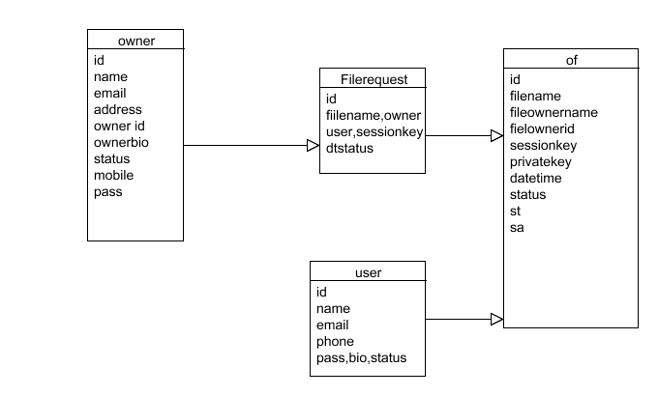
SYSTEM DESIGN
ER DIAGRAM

Slide 10
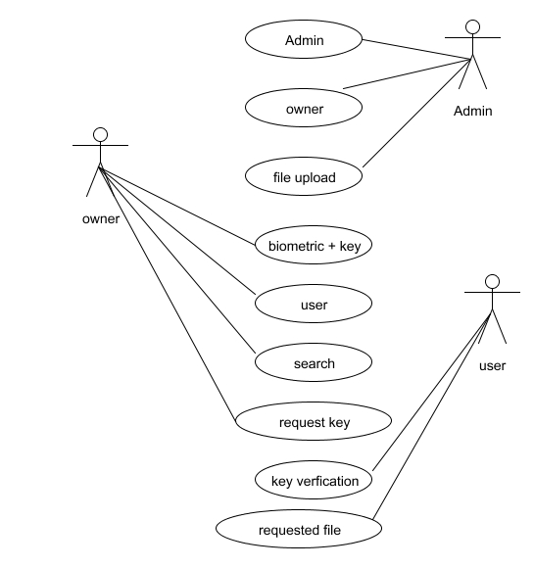
UML DIAGRAMS
USECASE DIAGRAM

Slide 11
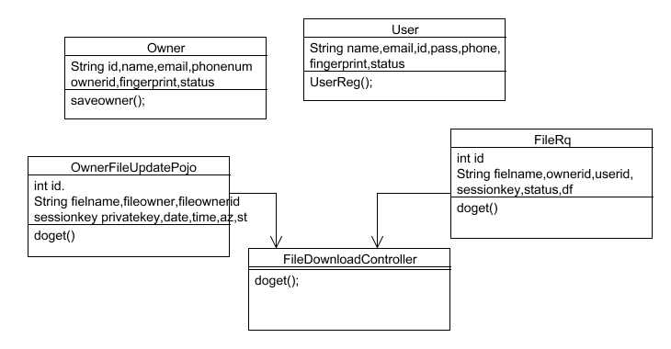
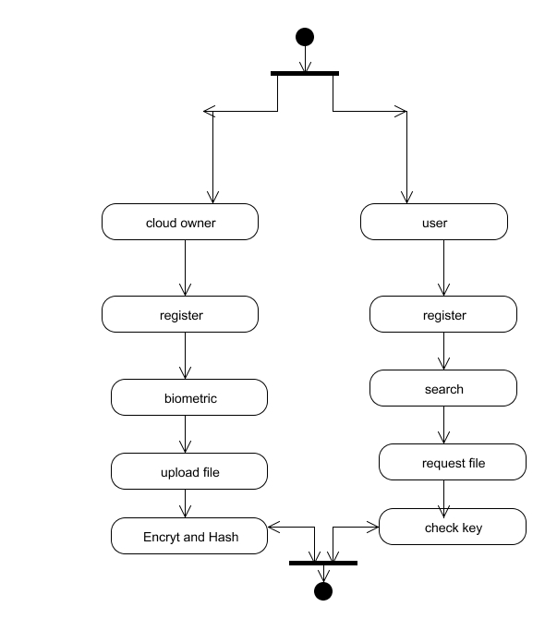
CLASS DIAGRAM
ACTIVITY DIAGRAM

Slide 12
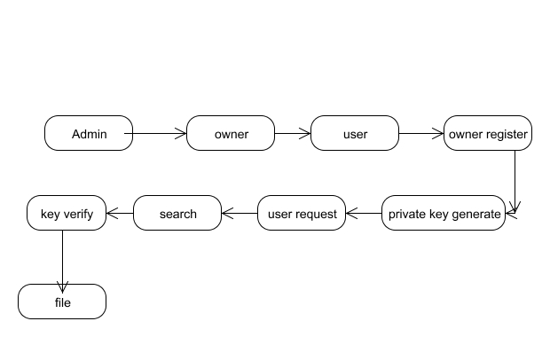
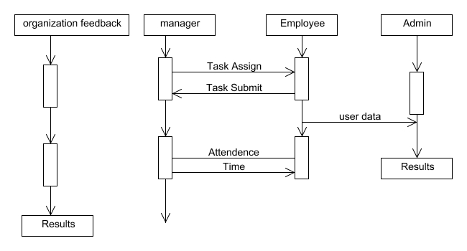
COLLABORATIVE DIAGRAM
SEQUENCE DIAGRAM

Slide 13
DATA FLOW DIAGRAM
DFD LEVEL 0:
Owner /user
Register
Biometric
Generate key
Remote Server
DFD LEVEL 0:
Server
Owner
User
Authentication
Proceed

Slide 14
DFD LEVEL 2:
Owner
Upload file
Bio key
Encrypt key
Server key verification
DFD LEVEL 3:
User
Search
Request File
Key sent
User view file

Slide 15
Cloud Owner and User Registration & Key Generation
Remote Server Authentication between Devices
Cloud Owner Upload File to Remote Cloud Server
Cloud User Decrypt and Download file
MODULES USED:
ALGORITHM USED
RSA algorithm
Base 64
Diffie Hellman algorithm

Slide 16
CLOUD OWNER AND USER REGISTRATION &KEY GENERATION
Initially user need to create a account in the cloud sever by providing all the necessary information related to the user like email id, mobile number, age name, password and Cloud Owner a biometric ﬁngerprint then server will generate a unique identity for that Owner and User.
Once Owner And User successfully register then user request to Key Generation centre to provide the keys to user by providing the unique id that was generated by the server.
User can access the Cloud data only if he registers their name in key generation centre.

Slide 17
CLOUD OWNER UPLOAD FILE TO CLOUD SERVER
User can able to upload any file in the cloud in order to provide security to the file user need to encrypted the file in the cloud .
Cloud contain the only the encrypted format information about the file and corresponding parameter related to the file.
In order to maintain security user initially generated the parameter related to the file and along with the mode to upload the data mode as public or private if private then user need to specify the client or mention group of people who can access or download the file then based on these parameter RSA will generate a key and sent to the user based in these key user would encrypt the file and upload to server.

Slide 18
DECRYPT AND DOWNLOAD FILE
Then User would search the file based on the parameter if any parameter match in the server, then the server will load the entire related file to that parameter.
Before download any file from the sever the user would also need to mutual authentication to the server, if user ﬁngerprint authenticated to the server then he access the file as file is in encrypted format user need to decrypt the file to decrypt the file user request to KGC (Key Generation Centre) for key along with the file parameter and user attribute then user can able to download the file.

Slide 19
SYSTEM TESTING
VALIDATION TESTING
Interfacing errors have been uncovered and corrected and a final series of software test-validation testing begins.
Software validation is achieved through a series of black box tests that demonstrate conformity with requirement.
After validation test has been conducted, one of two conditions exists.
1. The function or performance characteristics confirm to
specifications and are accepted.
2. A validation from specification is uncovered and a deficiency
created.
USER ACCEPTANCE TESTING
The system under consideration is tested for user acceptance by constantly keeping in touch with prospective system and user at the time of developing and making changes whenever required
This is done in regarding to the following points.
Input screen design.
Output screen design.

Slide 20


Slide 21
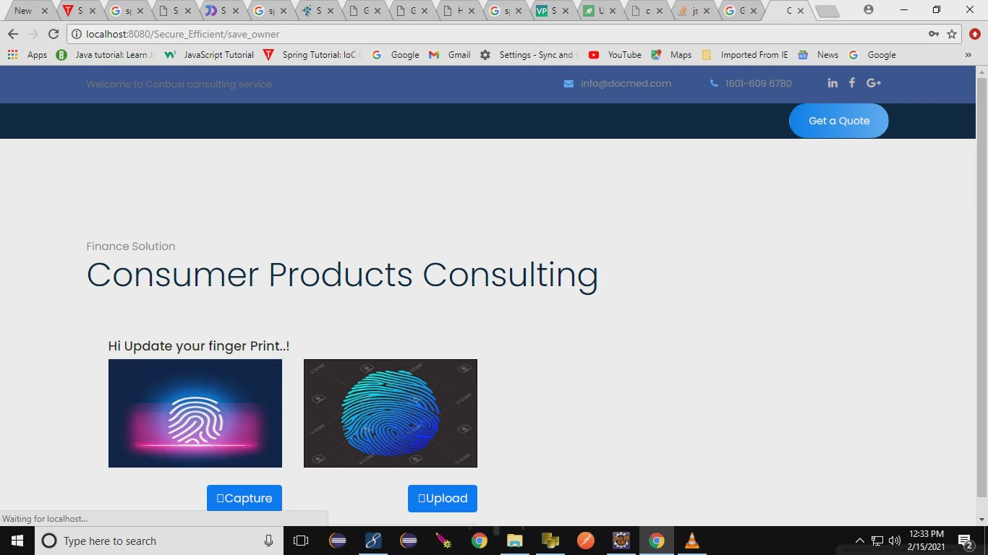

Slide 22
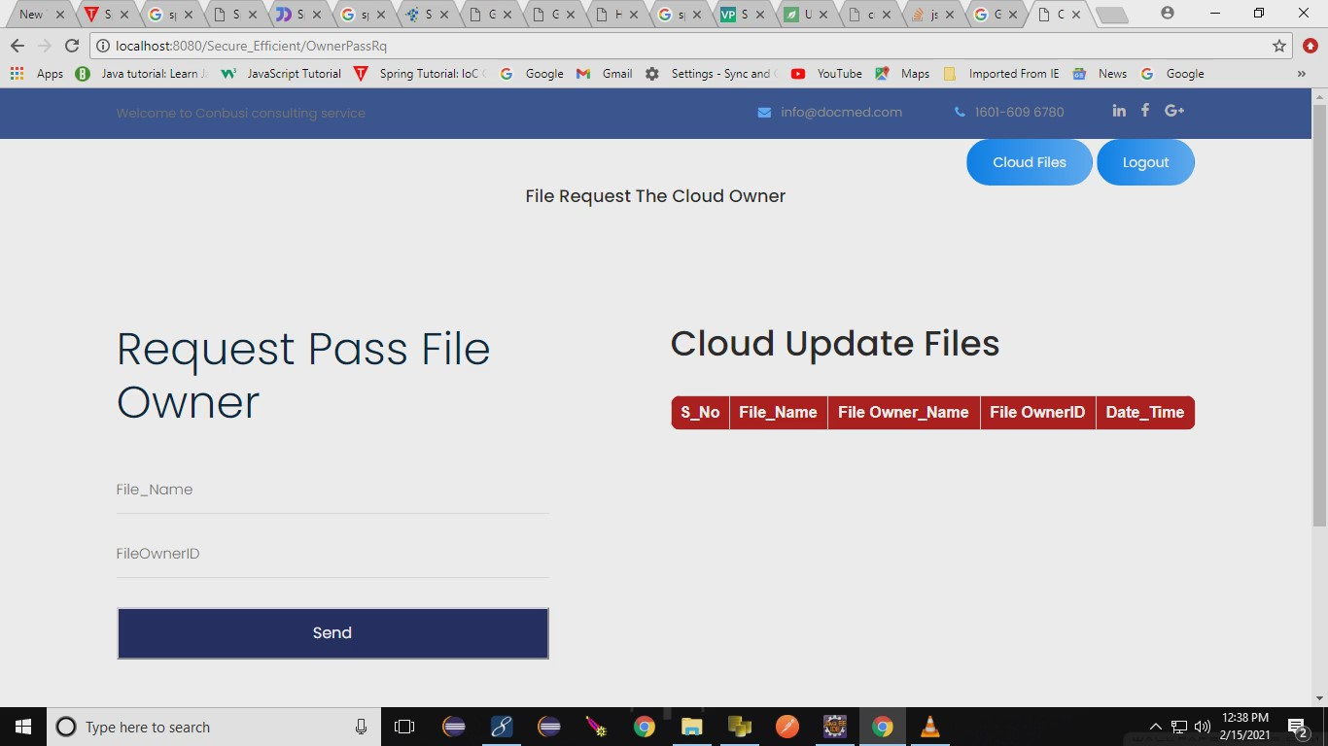

Slide 23
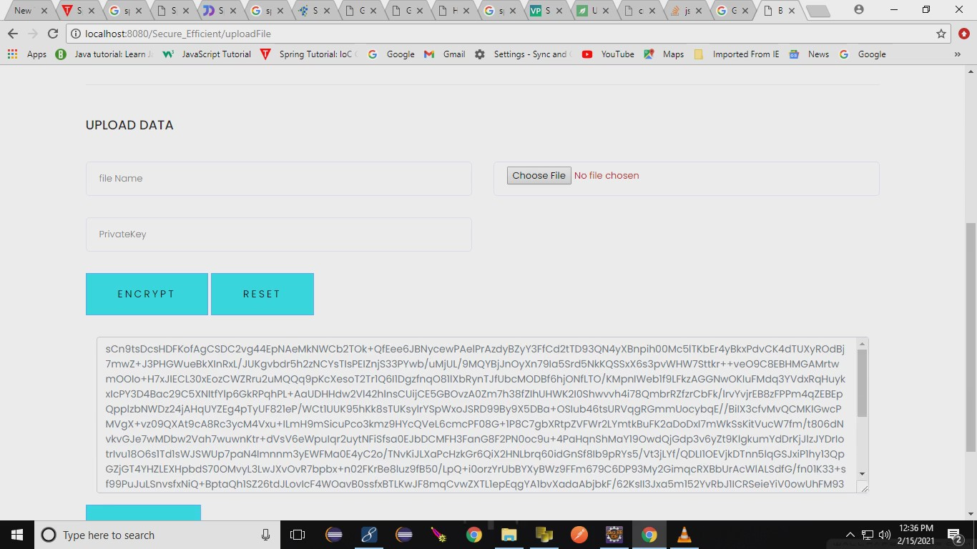

Slide 24
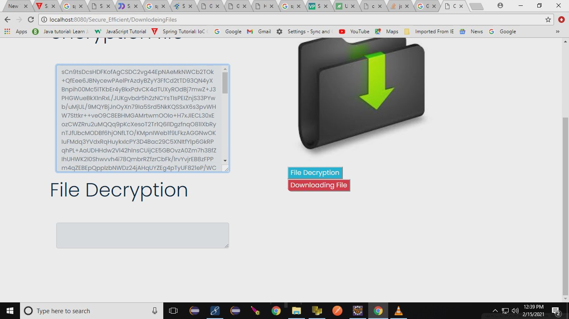

Slide 25
REFERENCES
Wenchang Yang, Song Wang,Jiankun Hu, Guanglou Zheng and Craig Valli ,”Security and Accuracy of Fingerprint-Based Biometrics: A Review” Received: 2 December 2018; Accepted: 23 January 2019; Published: 28 January 2019
Zhihua Xia, Xingming Sun, Neal N. Xiong ,”A Novel Weber Local Binary Descriptor for Fingerprint Liveness Detection” IEEE Transactions on Systems, Man, and Cybernetics: Systems · January 2018
Srinivas Jangirala, Mohammad Wazid,”Anonymous Lightweight Chaotic Map-Based Authenticated Key Agreement Protocol for Industrial Internet of Things” IEEE Transactions on Dependable and Secure Computing · July 2018
C. Yuan, X. Sun, and Q. M. J. Wu, “Difference co-occurrence matrix using BP neural network for fingerprint liveness detection,” Soft Computing, vol. 23, no. 13, pp. 5157–5169, 2019.
S. Roy, S. Chatterjee, A. K. Das, S. Chattopadhyay, S. Kumari, and M. Jo, “Chaotic Map-Based Anonymous User Authentication Scheme With User Biometrics and Fuzzy Extractor for Crowdsourcing Internet of Things,” IEEE Internet of Things Journal, vol. 5, no. 4, pp. 2884– 2895, Aug 2018.

